Slide 1

FINANCIAL ACCOUNTING AND REPORTING

Slide 2
Module -1 Introduction to Accounting
Definition of Accounting -
The American Institute of certified public accountants defines accounting as “The art of accounting, classifying and summarizing in a significant manner and in terms of money transactions and events which are in part of at least of a financial character and interpreting the results there of-

Slide 3
Objectives of Accounting -
1. To maintain systematic record.
2. To Ascertain Profit and Loss.
3. To Ascertain Financial position.
4. To Provide Information to users.
5. To Assist in Management.
6. To provide evidence in legal Matters.
7. To help in determining Tax Liability.

Slide 4
Types of Accounting –
There are mainly three type of Accounting as shown in the below Diagram.
1. Financial Accounting.
2. Management Accounting.
3. Cost Accounting.
4. Tax Accounting.
5. Auditing.
6. Govt Accounting.

Slide 5
1. Financial Accounting -
Financial accounting is the process of recording, summarizing, and reporting a business's financial transactions to stakeholders like investors, creditors, and regulators. It involves preparing financial statements, such as the income statement, balance sheet, and cash flow statement, that provide a snapshot of a company's financial performance and position. This external-facing process helps external parties assess the company's profitability and overall financial health.

Slide 6
2. Management accounting -
Management accounting is using financial and non-financial information to help internal managers make decisions, such as creating budgets, analyzing costs, and evaluating performance. Unlike financial accounting, which is for external reporting, management accounting is used within a company to plan, control, and guide operations.

Slide 7
3. Cost Accounting -
Cost Accounting is classifying, recording an appropriate allocation of expenditure for the determination of the costs of products or services, and for the presentation of suitably arranged data for the purpose ose of control and guidance of management.
4. Tax accounting -
Tax accounting is a set of accounting methods that focuses specifically on calculating and managing tax liabilities for individuals, businesses, and other entities. Its primary purpose is to ensure compliance with tax laws and prepare information for tax authorities, rather than for public financial reporting.

Slide 8
5. Auditing-
Auditing is the systematic examination and verification of a company's financial records, statements, and operations to ensure their accuracy, completeness, and compliance with relevant standards.
In contrast, accounting is the process of recording, summarizing, and reporting financial transactions. Auditing provides an independent and objective assessment to build credibility for financial reports, while accounting creates the reports that are then audited.

Slide 9
6. Govt accounting-
Recording, classifying, and summarizing financial transactions of government entities, focusing primarily on transparency, accountability, provides a framework to ensure that taxpayer money is used efficiently, effectively, and in compliance with legal and regulatory requirements.

Slide 10
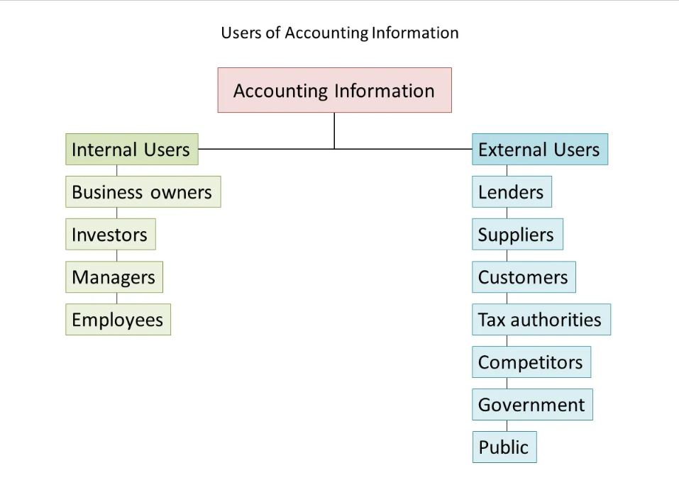
Users Of Accounting Information

Slide 11
Need / Scope of Accounting –
1. Business Forecasting.
2. Proper Decision Making.
3. Correct Taxation.
4. Analyzing the performance of the Business.
5. Documentary Evidence.
6. Helping in Realization of department.
7. Preventing and Detecting Froud's.

Slide 12
Concepts of Accounting –
Concepts –
1. Separate Entity Concept
2. Going Concern Concept.
3. Money Measurement Concept.
4. Accounting Period Concept.
5. Cost Concept.
6. Dual Aspect Concept.
7. Accrual Concept.
8. Matching Concept
9. Realization concept.
10. Full Disclosure Concept.

Slide 13
Separate Entity Concept–
There is a presumption under Separate Entity Concept that as far as accounting is concerned the 'owners of a business organization' and the 'business organization itself are two independent and separate comities. The business transactions undertaken by the owner are altogether separate.
Going Concern Concept –
Concern is one of the fundamental assumption accounting on the basis of which financial statements are prepared. The assumption is that a business entity will continue to operate in the foreseeable future without the need or intention on the part of management to liquidate the entity and it will realize its assets and settle its obligations in the normal course of the business.

Slide 14
Money Measurement Concept –
In accounting, every transaction is recorded in terms of money, ie, rupees and paise in India. Receipt of income, payment of expenses, purchase and sale of assets, etc., are monetary transactions and therefore are recorded in the books of accounts.
Accounting period concept –
The accounting period concept is a fundamental accounting principle that requires a business's long economic life to be divided into shorter, standardized time intervals for reporting purposes. This allows companies to prepare financial statements like profit and loss accounts and balance sheets at regular intervals, such as monthly, quarterly, or annually, to assess performance.

Slide 15
Cost Concept –
The cost concept in accounting, also known as the historical cost principle, states that assets should be recorded at their original purchase price, not their current market value. This principle ensures objectivity and reliability in financial statements because historical costs are verifiable and less subjective than market values.`
The dual aspect concept in accounting states that every business transaction has two equal and opposite effects, forming the basis of the double-entry bookkeeping system. This means for every debit there is a corresponding, equal credit, ensuring the fundamental accounting equation (Assets=Liabilities Equity)) remains balanced.
Dual aspect concept–

Slide 16
Accrual Concept–
The accrual concept in accounting records revenues and expenses when they are earned or incurred, regardless of when cash is exchanged. This principle provides a more accurate picture of a company's financial performance by matching revenues with the expenses that helped generate them within the same period.
Matching Concept–
The matching concept is an accounting principle that requires expenses to be recorded in the same accounting period as the revenues they helped generate. This principle ensures a company's profitability is accurately reported by linking the costs of doing business directly to the income they produced.

Slide 17
Realization Concept–
The realization concept in accounting states that revenue should be recorded only when it has been earned and it is reasonably certain that cash will be receive and, not just when a customer places an order or pays in advance.

Slide 18
Conventions of Accounting –
1. Convention Consistency.
2. Convention of Conservation.
3. Convention of materiality.
4. Convention of full Discourse.

Slide 19
Single Entry System: The term "Single entry system" means a system of maintaining the accounting records of the business transactions, in a manner convenient to a particular trader, where the principle of double entry is not applied for all the transactions. In other words, the single entry is an incomplete from of book-keeping.
Types of Single-Entry System
1. Pure Single-Entry System.
2. Simple Single-Entry System.
3. Quasi Single-Entry System.

Slide 20
Double-entry system of accounting is a method where every financial transaction is recorded with at least two entries: a debit to one account and a credit to another. This system ensures that total debits always equal total credits, which helps maintain the balance of the accounting.
Advantages –
  Complete and Scientific Record.
  Arithmetical Check of Account.
  Meet Legal Requirements.
  Helpful in Comparison.
  Help in Preparing Final Account.

Slide 21
Disadvantages –
  Expensive System.
  Needs Practical Knowledge.
  Accounting Errors.
  Difficult to understand.
  Time Consuming.

Slide 22
Generally Accepted Accounting Principles.(GAAP)
Meaning:
GAAP refers to a set of accounting rules, principles, and procedures used by companies to prepare and present their financial statements.
These principles ensure that financial information is consistent, transparent, and comparable across different organizations within a country.
Full form: GAAP - Generally Accepted Accounting Principles
Purpose:
To maintain uniformity in financial reporting.
To make financial statements reliable and understandable.
To help investors, regulators, and management make informed decisions

Slide 23
IFRS:- International financial reporting System IFRS are increasingly recognized has global accounting standard for the purpose of preparing presenting general purpose reports including financial statement.

Slide 24
Thank You

